Slide 1
Cluster analysis
Mark Green
DASC507 – Advanced Biostatistics II
Analysis Methods for Complex Data Structures

Slide 2
Outline
Dealing with point data
Spatial weights
Global Moran’s I
Local Moran’s I
Criticisms
Case study

Slide 3
Introduction
What do we mean when we talk about ‘clusters’?
Dictionary definition “a group of similar things or people positioned or occurring closely together”
Spatial proximity is explicit – concentration in places
Need to identify if occurred by random chance (size can be key) or explained by other geographical phenomena
How we can identify clusters will depend on the type of data…

Slide 4
Dealing with point data
We can plot points, but how do we know if their locations are clustered?

Slide 5
Dealing with point data
Let’s take an example…
Shiode et al. 2015. The mortality rates and the space-time patterns of John Snow’s cholera epidemic map. International Journal of Health Geographics 14: 21.

Slide 6
Dealing with point data
Kernel density estimation one approach for smoothing over space to generalise spatial patterns (and describe possible clusters)

Slide 7
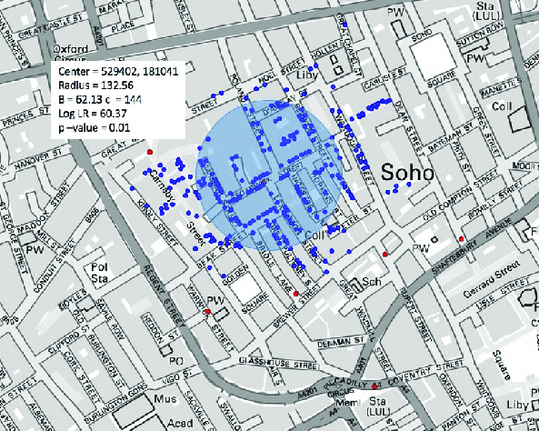
Dealing with point data
There are more formal ways of testing for spatial clustering of point data (e.g., SatScan)
Prasad et al. 2017. https://doi.org/10.1109/BigDataCongress.2017.39

Slide 8
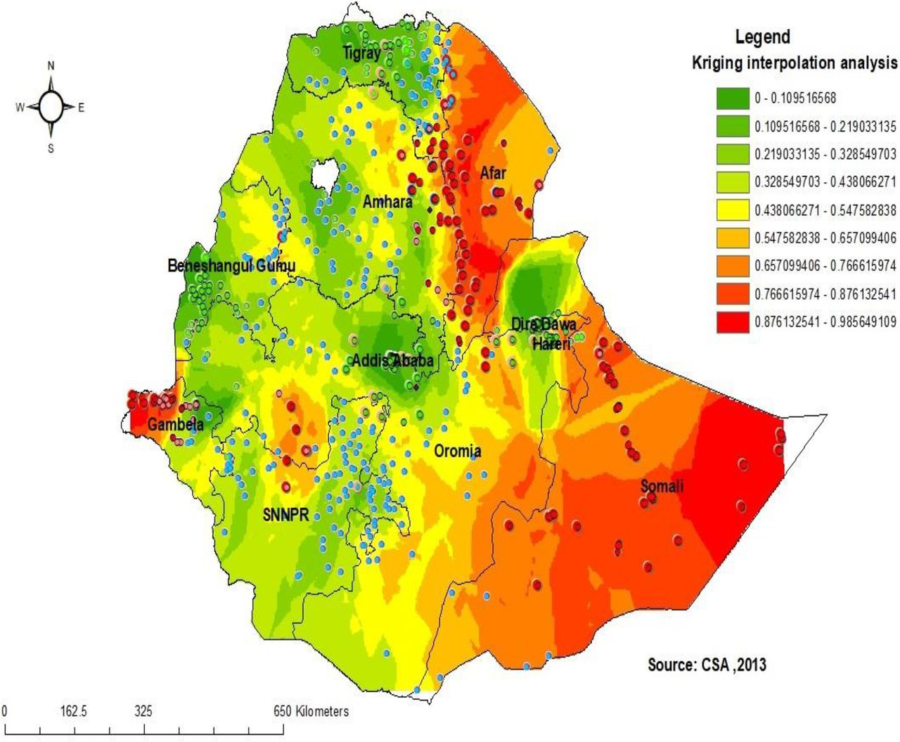
Dealing with point data
If we have sparse data points, we might try to estimate values inbetween using spatial interpolation methods – lots of methods for this
Agegnehu CD, Alem AZ. 2021. Exploring spatial variation in BCG vaccination among children 0–35 months in Ethiopia: spatial analysis of Ethiopian Demographic and Health Survey 2016. BMJ Open 11:e043565. http://doi.org/10.1136/bmjopen-2020-043565

Slide 9
Spatial autocorrelation
Data in one area are correlated to the data in areas surrounding them
Each data point should have it’s own (unique) location
Define which locations are next to each other
How to measure distances between data points

Slide 10
Spatial weights
How might we represent the spatial structure of data if we want to model it statistically?
Need to make spatial location explicit
Each data point should have it’s own (unique) location
Define which locations are next to each other
How to measure distances between data points

Slide 11
Spatial weights
To formally define the spatial structure of data, we define W as
N x N (positive) matrix for all data points
Contains information over if each point i is related to each other point j
Commonly, Wij > 0 if i and j are neighbouring, else Wij = 0 (not neighbours)
Wii is always 0
How can we define a neighbour?

Slide 12
Spatial weights
Contiguity-based weights
Which areas are ‘next’ to others
Defined based on sharing a common boundary
Rook – must share long boundary
Queen – any point is touching
If an area shares a common boundary, then Wij = 1
If not a neighbour, then Wij = 0

Slide 13
Spatial weights
Distance-based weights
How close are other areas
W defined as (inversely) proportional to distance between each data point
Distance (e.g., how near are each area) – may have threshold cut-point
Distance as buffer (e.g., select areas within 500m of an area)
K-Nearest Neighbours (e.g., select k=4 nearest areas only)
Wij can be either binary (e.g., Wij = 1 if defined by KNN) or as continuous if based on distance (0 < Wij < 1) where larger values are closer
If not a neighbour, then Wij = 0

Slide 14
Spatial weights
Block weights
Is the area within the same ‘place’ as other areas
Weights depend on whether areas are located in particular (larger) areas
Small administrative zones located within larger zones
Postcode within a electoral ward/city
If an area is located within a particular zone, then Wij = 1
If not a neighbour, then Wij = 0

Slide 15
Spatial weights
Selecting the correct weight
Depends on the nature of the spatial process you are measuring
If process has an immediate impact, then contiguity will work best
If need to incorporate a wider spatial extent (e.g., accessibility) then distance-based weights preferred
If data are multi-level or reflect a specific process by area structure (e.g., policies implemented in certain areas) then use block-based
If just interested in the statistical nature, contiguity often used

Slide 16
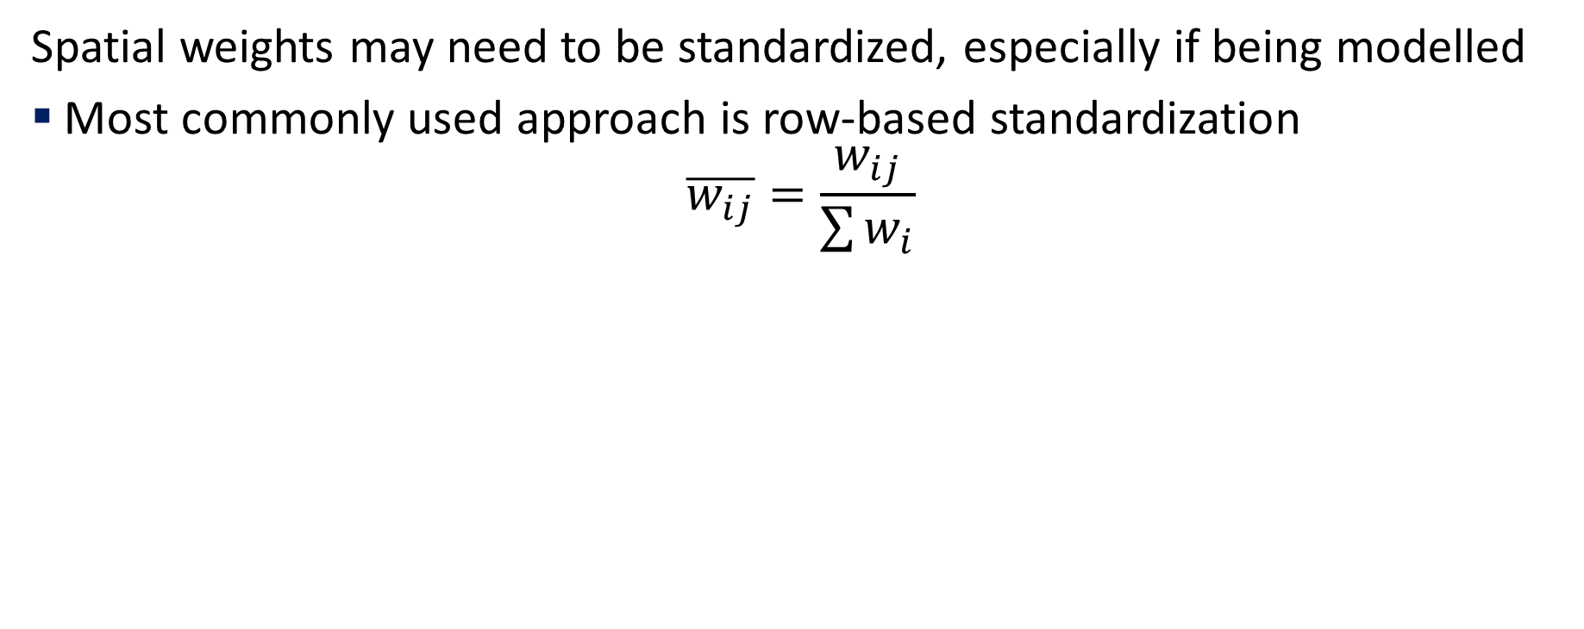
Spatial weights
Spatial weights may need to be standardized, especially if being modelled
Most commonly used approach is row-based standardization
$$\overline{w_{ij}}=\frac{w_{ij}}{\sum{w_{i}}}$$

Slide 17
Spatial autocorrelation
Data in one area are correlated to the data in areas surrounding them
Each data point should have it’s own (unique) location
Define which locations are next to each other
How to measure distances between data points

Slide 18
Global Moran’s I
Summary measure describing the overall nature of clustering in a dataset (i.e., describing the general spatial patterning of values)
Visualised using a scatter plot (also termed Moran Plot)
X-axis: Spatially lagged outcome variable (y) – for each area I, calculate an average of y for surrounding areas by weighting values by W.
Y-axis: outcome variable value for an area
This allows us to compare how similar an area (Yi) is to its surrounding neighbouring areas (WYi)
Variable and spatial weights should be standardised

Slide 19

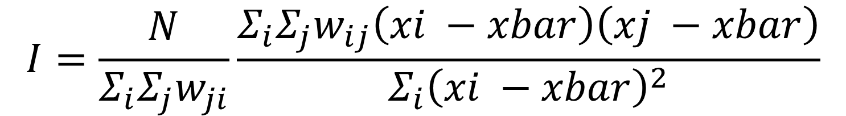
Global Moran’s I
We can calculate a single statistic to describe the presence of clustering (equivalent to the line of best for the Moran’s Plot).
Values run from -1 to +1 where:
+1 is perfect clustering (i.e., high values located by high values, vice versa)
0 is a random pattern (no clustering)
-1 is a dispersed pattern of alternating high then low (rare) ->
$$I=\frac{N}{Σ_{i}Σ_{j}w_{ji}}\frac{Σ_{i}Σ_{j}w_{ij}\left(xi −xbar\right)\left(xj −xbar\right)}{Σ_{i}{\left(xi −xbar\right)}^{2}}$$

Slide 20
Local Moran’s I
If we find existence of clustering overall, then the next question is where is that clustering located
Clusters can be defined as:
High-high – hotspots or areas with spatial autocorrelation of high values (i.e., areas of high values, surrounded by areas of high values)
Low-low – coldspots or areas with spatial autocorrelation for lower values (i.e., areas of low values, surrounded by areas of low values)
High-low – a spatial outlier with an area of high value surrounded by lower values
Low-high – as above, but other way round

Slide 21
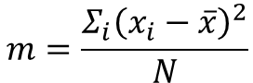
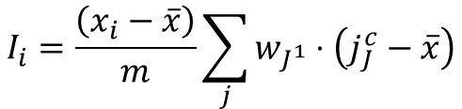
Local Moran’s I
If we find existence of clustering overall, then the next question is where is that clustering located
Monte Carlo approach for significance – compares observed patterns, with many simulated random patterns to see how likely it would be to find these observed patterns
$$I_{i}=\frac{\left(x_{i}−\overline{x}\right)}{m}\sum_{j}{w_{J^{1}}}⋅\left(j_{J}^{c}−\overline{x}\right)$$
$$m=\frac{Σ_{i}{\left(x_{i}−\overline{x}\right)}^{2}}{N}$$

Slide 22
Criticisms
Formal definitions of spatial structure are rigid
Area size may distort patterns (e.g., a large area sharing a common boundaries has same weighting as a smaller one)
Spatial structure harder to formalize when measuring ‘communities’
Descriptive tools that cannot help us to explain clustering processes (but knowing ‘where’ allows us to ask ‘why’)
Neutral global Moran’s I can often hide local patterns
Moran’s I statistics require continuous measures

Slide 23
Case study
Yourkavitch et al. 2018. Using geographical analysis to identify child health inequality in sub-Saharan Africa. PLoS One 13(8): e0201870.
Mapping Sustainable Development Goals (SDG) important for tracking progress
Aggregate measures for countries ignores spatial heterogeneity (including where progress may be further behind)
Consider 6 SDG metrics for child health
Sub-regional metrics estimated from Demographic and Health Surveys

Slide 24
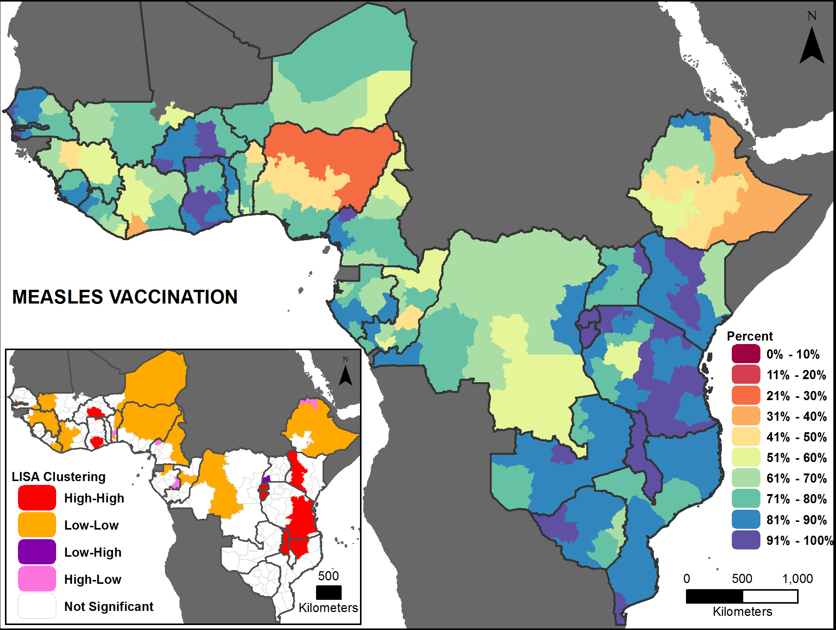
Case study
DPT3 immunisations (measles, diptheria, pertussis and tetanus)
I = 0.52
Low coverage often in rural regions, but large heterogeneity across countries

Slide 25
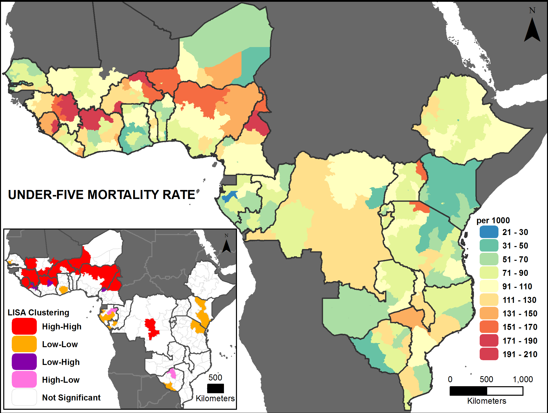
Case study
Under-5 mortality
I = 0.41
Higher rates in Western Africa, especially rural regions
Also not distinct spatial pattern, suggests caution of focusing only on the statistic

Slide 26
Further reading
Anselin L. 1995. Local Indicators of Spatial Association – LISA. Geographical Analysis 27(2): 93-115. https://doi.org/10.1111/j.1538-4632.1995.tb00338.x
Carlos et al. 2010. Density estimation and adaptive bandwidths: A primer for public health practitioners. International Journal of Health Geographics 9: 39. https://doi.org/10.1186/1476-072X-9-39
Shiode et al. 2015. The mortality rates and the space-time patterns of John Snow’s cholera epidemic map. International Journal of Health Geographics 14: 21. https://doi.org/10.1186/s12942-015-0011-y
Walther G. 2010. Optimal and fast detection of spatial clusters with scan statistics. Annals of Statistics 38(2):1010-1033. https://doi.org/10.1214/09-AOS732

